Slide 1
Fishbone Diagrams
Participant and Leader Training

Slide 2
Training Objectives
This training covers the following Fishbone Diagram topics
Purpose & structure
Creating a fishbone diagram
Limitations
Examples

Slide 3
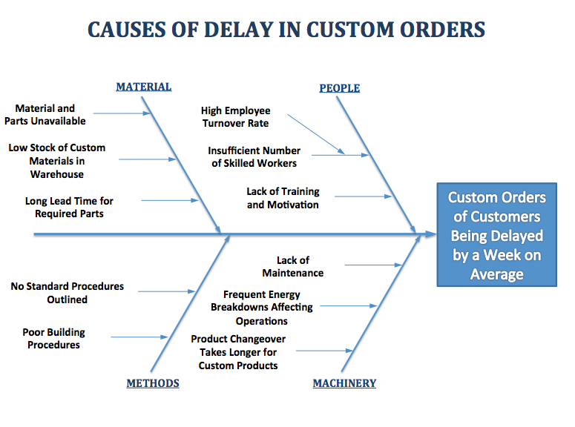
Fishbone Diagram Purpose & Structure
A fishbone diagram organizes possible causes into a visual format that can be quickly understood.

Slide 4
Fishbone Diagram Purpose & Structure
Fishbone diagrams contain three elements
Problem statement – describes the problem being considered
Cause groupings – logical grouping for causes - there can be as few or as many cause groups as needed
Individual causes – these are the specific causes that make up each group

Slide 5
Fishbone Diagram Purpose & Structure
1
Problem Statement

Slide 6
Fishbone Diagram Purpose & Structure
2
Cause Groupings

Slide 7
Fishbone Diagram Purpose & Structure
3
Individual Causes

Slide 8
Training Objectives
This training covers the following Fishbone Diagram topics
Purpose & structure
Creating a fishbone diagram
Limitations
Examples

Slide 9

Creating a Fishbone Diagram – 8 Steps
We have found the following eight-step approach to be very effective –
Communicate the objective
Show an example of a completed fishbone diagram
Let the team know that all potential causes will be included on the diagram
Ask team members to write their ideas on large sticky notes (3”x3” work well), and stick them on a white-board or wall

Slide 10
Creating a Fishbone Diagram – 8 Steps (continued)
Keep the meeting moving and avoid discussing any one cause for too long
Once everyone’s ideas are listed, group the causes under major headings and eliminate the duplicates
When the diagram is finished, ask the team members for their thoughts on the top causes to investigate first
Take a picture of the sticky-note fishbone diagram and use it to

Slide 11
Training Objectives
This training covers the following Fishbone Diagram topics
Purpose & structure
Creating a fishbone diagram
Limitations
Examples

Slide 12
Fishbone Diagram Limitations
Three things to keep in mind….
A fishbone diagram usually includes possible causes, identified in a team setting
Typically only a handful (or less) of the possible causes will have a significant impact on the problem
Finding out which causes have the most impact on the problem is typically out of scope for a fishbone diagram exercise
Fishbone diagrams are mostly about organizing and communicating potential causes

Slide 13
Training Objectives
This training covers the following Fishbone Diagram topics
Purpose & structure
Creating a fishbone diagram
Limitations
Examples

Slide 14
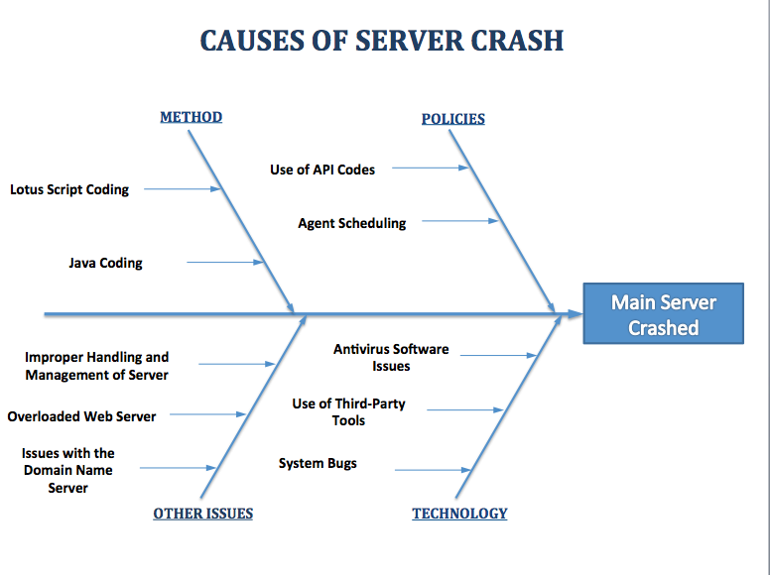

Slide 15
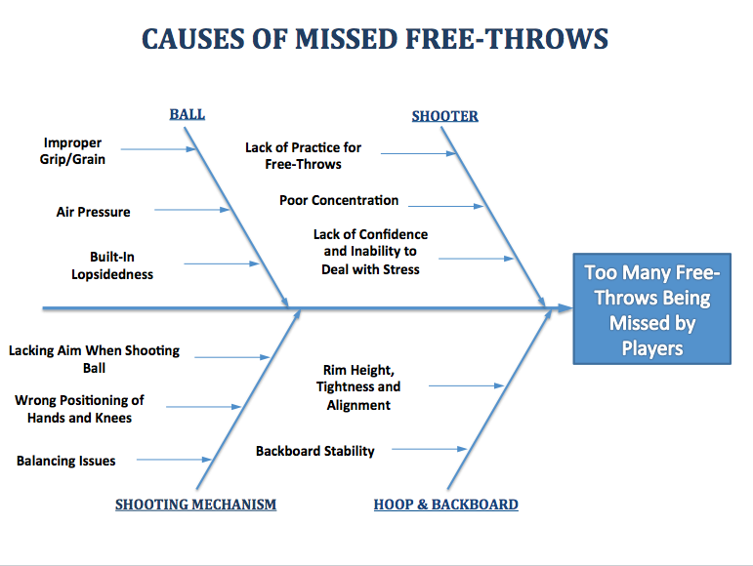

Slide 16
Summary
The fishbone diagram is a great tool for organizing and communicating potential causes to a given problem
The problem statement lies at the “head” of the fish, and the problems are grouped along the “bones”
Once a fishbone diagram is complete, other methods are available to rule potential causes in or out, as major contributors (including designed experiments, hypothesis testing, and Pareto charts)

